Slide 1
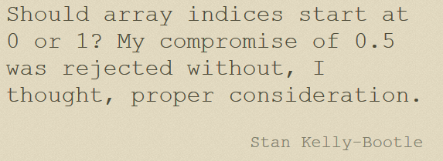

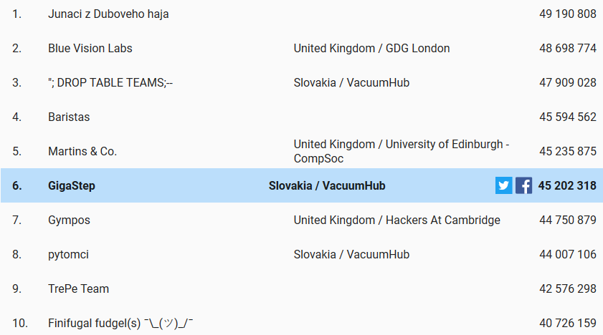
Zrnko múdrosti

Slide 2
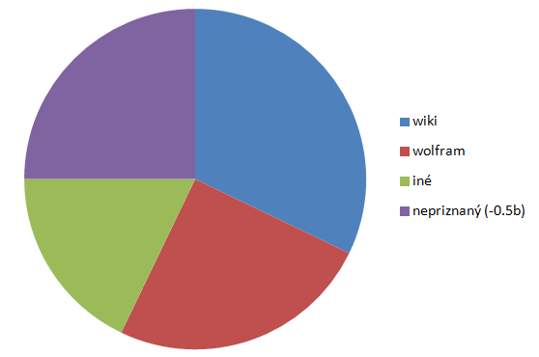



O krájaní pizze
good artists copy,
great artists steal
Picasso
Lenže toto nie je umenie ale príšerne napísaný kód:
(int)((Math.pow(n, 4) - (6 * Math.pow(n, 3)) + (23*Math.pow(n,2)) - (18*n) + 24)/24)
=
(n*n*n*n -6*n*n*n + 23*n*n - 18*n + 24)/24
=
((((n-6)*n+23)*n-18)*n+24)/24
=
(((n-6)*n+23)*n-18)*n/24+1
The Winner is (Animated Math):
http://www.3blue1brown.com/videos/2017/5/26/y4nc90ncml3r7kglv36szd72jlm90e

Slide 3

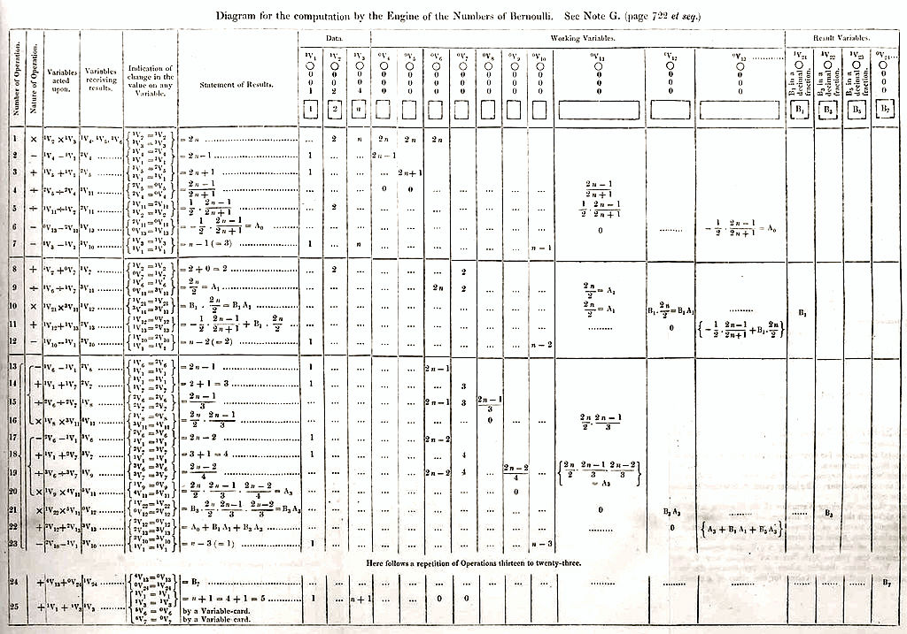

http://cdn.history.com/sites/2/2015/12/Diagram_for_the_computation_of_Bernoulli_numbers.jpg

Slide 4

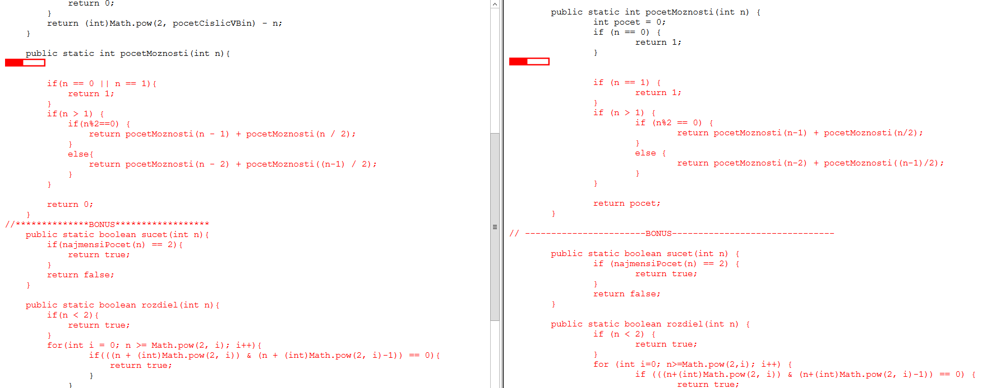

Kto číta vaše kódy
(Moss = Measure Of Software Similarity)
MOSS - Standford System for Detecting Software Plagiarism

Slide 5


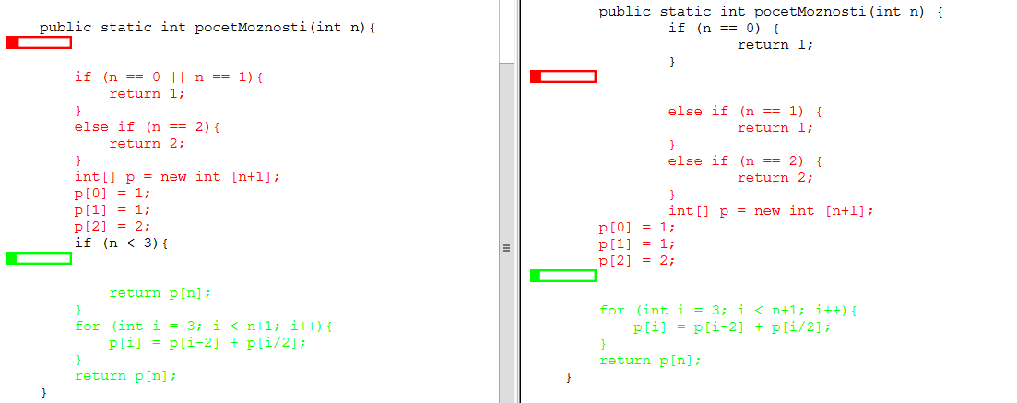

Slide 6


Prémia nuly
(koľkátimi nulami končí n nad k)
http://sk.wikipedia.org/wiki/Binomick%C3%A1_veta
int dve=0, pat=0;
// nuly v čitateli
for(int i=n; i>n-k; i--) {
int c = i;
while (c>0)
if (c%2 == 0) {
dve++; c /= 2;
} else if (c%5 == 0) {
pat++; c /= 5;
} else break;
}
// nuly v menovateli
for(int i=2; i<=k; i++) {
int c = i;
while (c>0)
if (c%2 == 0) {
dve--; c /= 2;
} else if (c%5 == 0) {
pat--; c /= 5;
} else break;
}
return Math.min(dve,pat);
http://dai.fmph.uniba.sk/courses/JAVA/sources/Premia_o_Nulach/

Slide 7
Prémia nuly zlé riešenie !!! prečo ??? nájdi jasný kontrapríklad (n, k).
public static int pocetNulNaKonciFaktoriala(int n) {
if (n <= 10) //pre každý násobok čísla 5 je jedna
return n / 5; // nula na konci
else if (n <= 100) //25 = 5*5 -> jedna extra nula za
return n/5 + n/25; // každý násobok čísla 25
else if (n <= 1000)
return n/5 + n/25 + n/125 + n/625; //125=5*5*5 atd.
else if (n <= 1000000 )
return n/5 + n/25 + n/125 + n/625 + n/3125 + n/15625 + n/78125 + n/390625;
return 0;
}
public static int bindiv10(int n, int k) { //odstránenie núl pri delení
int pocet = pocetNulNaKonciFaktoriala(n)
– pocetNulNaKonciFaktoriala(k)
- pocetNulNaKonciFaktoriala(n-k);
return (pocet <= 0)?0:pocet;

Slide 8
Prémia nuly – správne riešenie
Dobré – vychutnať sa dá, až pochopíme, prečo je zlé riešenie zlé
public static int pocetNasobok2(int n) {
if (n <= 10) {
return n/2 + n/4 + n/8; //to isté ako pri 5
} else if (n <= 100) {
return n/2 + n/4 + n/8 + n/16 + n/32 + n/64;
} else if (n <= 1000) {
return n/2 + n/4 + n/8 + n/16 + n/32 + n/64 + n/128 + n/256 + n/512;
} else if (n <= 1000000 ) {
return n/2 + n/4 + n/8 + n/16 + n/32 + n/64 + n/128 + n/256 + n/512 + n/1024 + n/2048
+ n/4096 + n/8192 + n/16384 + n/32768 + n/65536 + n/131072 + n/262144 + n/524288;
}
return 0;
}
public static int bindiv10(int n, int k) { //odstránenie núl pri delení
int pocet5 = pocetNasobok5(n)-(pocetNasobok5(k)+pocetNasobok5(n-k));
int pocet2 = pocetNasobok2(n)-(pocetNasobok2(k)+pocetNasobok2(n-k));
if (pocet5 <= pocet2 && pocet5 > 0) return pocet5;
if (pocet5 > pocet2 && pocet2 > 0) return pocet2;
return 0;
}

Slide 9
Móda kódu
public static int pocetNasobok2(int n) {
if (n <= 10) {
return n/2 + n/4 + n/8; //to iste ako pri 5
} else if (n <= 100) {
return n/2 + n/4 + n/8 + n/16 + n/32 + n/64;
} else if (n <= 1000) {
return n/2 + n/4 + n/8 + n/16 + n/32 + n/64 + n/128 + n/256 + n/512;
} else if (n <= 1000000 ) {
return n/2 + n/4 + n/8 + n/16 + n/32 + n/64 + n/128 + n/256 + n/512 + n/1024 + n/2048
+ n/4096 + n/8192 + n/16384 + n/32768 + n/65536 + n/131072 + n/261244 + n/524288;
}
return 0;
}
static int pocetNasobok2(int n,int m) {
if (m <= n)
return n/m + pocetNasobok2(n,m<<1);
else
return 0;
}
static int pocetNasobok2(int n){
int pocet = 0;
for (int m=2; m <= n; m *= 2)
pocet += n/m;
return pocet;
}
static int pocetNasobok2(int n, int m) {
return (m <= n)?n/m + pocetNasobok2(n,m<<1):0;
}

